Slide 1
ML-OPS CI/CD Design

Slide 2
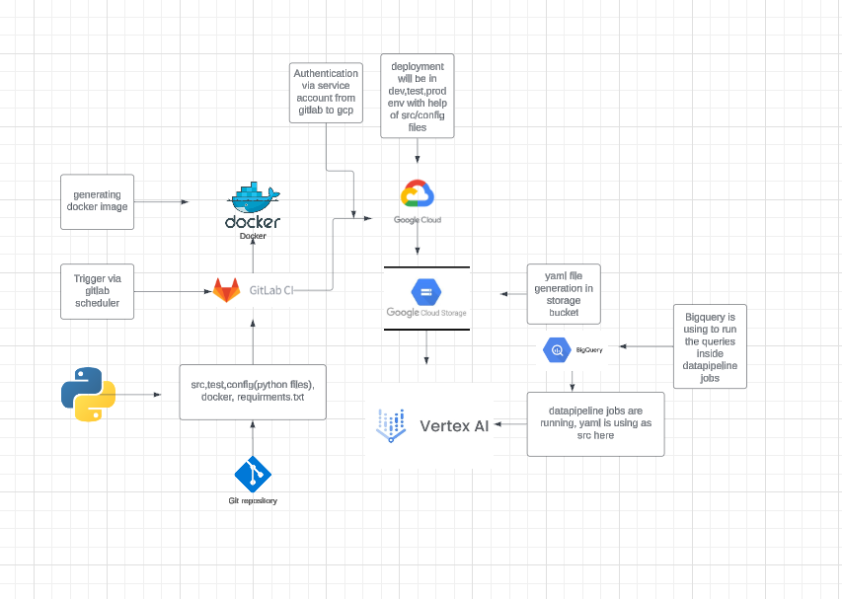
Overview

Slide 3
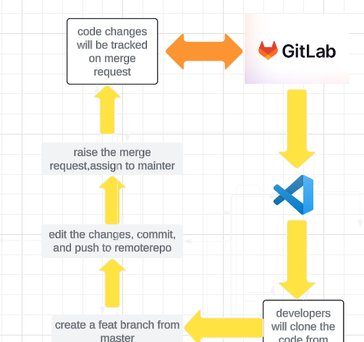
Repository
1)Developers will clone the repo from remote to local repo
2)They will create the feature branch from master branch
3)They will make the necessary changes and do the commit
4)They will push the code into remote repo and raise the merge request
5)In merge request we can track all the changes from all branches.

Slide 4
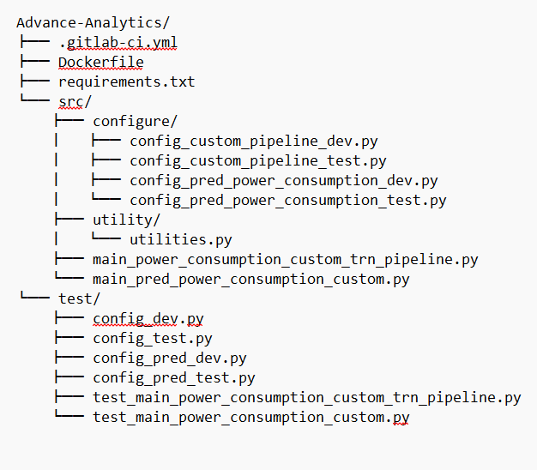
Repo Structure
.gitlab-ci.yaml:
Dockerfile: A file that defines the environment for a Docker container, used to package and run the use case’s code.
requirements.txt: A list of the Python packages required to run the pipeline.
src: Folder containing source code for training and prediction.
configure: Folder containing configuration files for the use case, including files for development and testing environments.
utility: Folder containing utility.
test: Folder containing test files, including test cases for the main scripts.

Slide 5
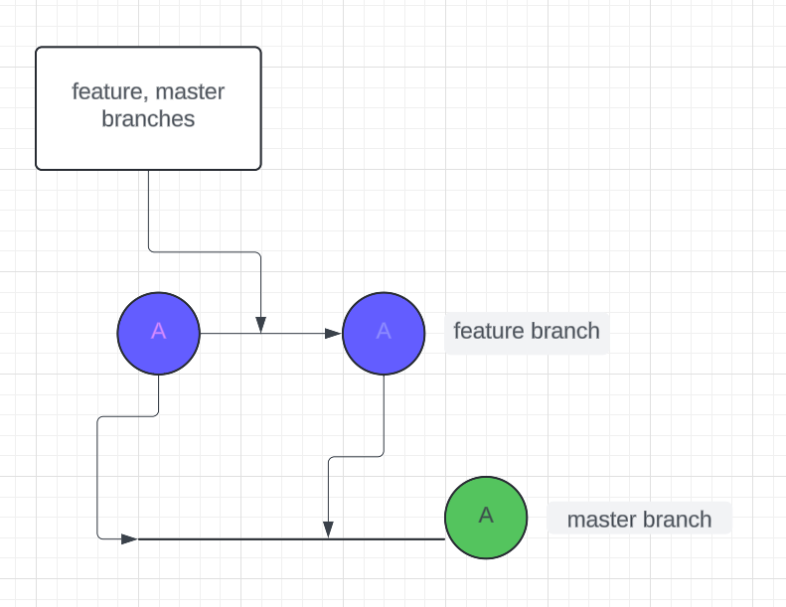
Branching
1)Currently we are using feature branch master branch.
2)Once code is pushed to remote repo developers will do the merge request against master branch from feature branch.
3)In merge request we have to add assignee and reviewer to review the code.

Slide 6
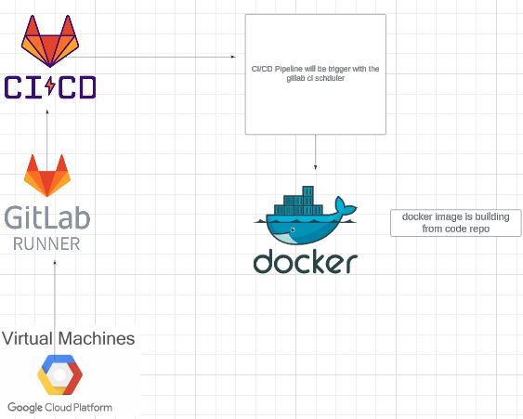
CI
1)Here we are using a gitlab-dedeicated runner which is hosted on gcp vm in order to trigger the pipeline.
2)The Pipeline triggering as scheduler in specific time interval.
3)Once the pipeline is triggered we have a three stages build, test and deploy
4)It will build docker image from the code.
5)Here docker is using the python-3.9 as base image
6)The base image is getting from docker hub opensource.
7)Then it is executing the test and deploy stage into the gcp.
8)It is authenticating as service account from gitlab ci/cd pipeline.

Slide 7
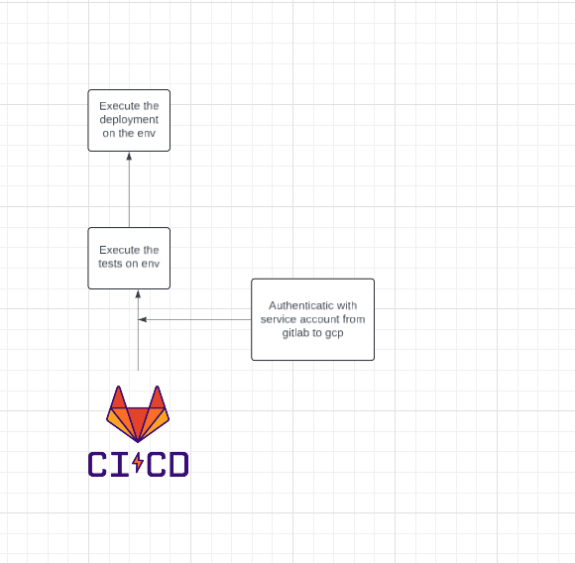
CD
1)Execute the tests on the respected env on the test stage in gcp.
2)Execute the deployment on the respected env on the deploy stage in gcp/
3)Here we are using the service account key as variable in gitlab-ci.yaml file to authenticate from gitlab ci/cd pipeline to gcp environment.

Slide 8
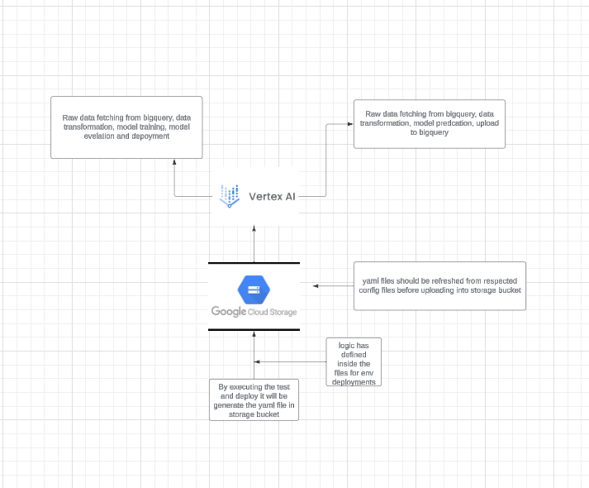
1)When test cases are executed it will refresh the yaml file with the code changes and generate the yaml file in gcp storage bucket
2)Then it is execute the data pipeline jobs in vertex ai.
3)Once the test are completed will execute the deployment on the env.
4)It will deploy the test and deployments in dev,test and prod environment by adding the
--env test,dev,prod flag at end of the docker run command at test and prod stage.
5)The logic we have defined inside the src/trn.py, src/pred.py.
6)Yaml will be refreshed from respected config files before uploading into storage bucket.

Slide 9
Pending Items
Regarding docker image push and pull, we have to use nexus repository so the nexus repo integration is inprogress.
Regarding the credentials calling from secrets manger into python files is inprogress.

